Slide 1
LEVELS OF STRATEGIC MANAGEMENT
Associate Professor & Head
School of Management
Gangadhar Meher University

Slide 2
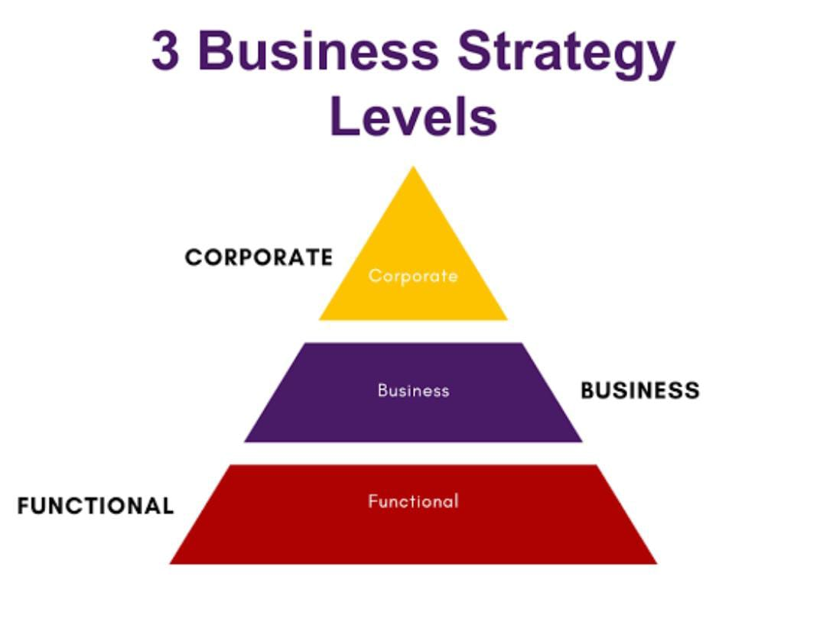
Definition of Strategic levels of Management Decision
Strategic levels of management decision refers to the hierarchical structure of decision-making within an organisation. It involves categorising decisions into three primary levels:
Corporate level
Business unit level
Functional level

Slide 3
CORPORATE LEVELS OF STRATEGIC MANAGEMENT
Corporate level strategic management refers to the highest level of strategic decision-making within an organization. It involves developing and implementing strategies to achieve overall organizational goals and objectives.
Characteristics :-
1.Focus on the entire organisation
2.Concerned with long-term direction and scope
Benefits:-
1.Provides overall direction and purpose
2.Enhance organizational competitiveness
3.Allocates resources effectively

Slide 4
BUSINESS LEVELS OF STRATEGIC MANAGEMENT
Business levels strategic management focuses on developing and implementing strategies to achieve specific business unit goals and objectives. It involves analysing the competitive environment, identifying opportunities and threats, and allocating resources to gain a competitive advantage.
Characteristics:-
1.Focuses on a specific business unit or department
2.Concerned with competitive advantage and market positioning
3.Involves middle management and business unit leaders
Benefits:-
1.Enhances competitive advantage
2.Improves market positioning
3.Increases operational efficiency

Slide 5
FUNCTIONAL LEVEL STRATEGIC MANAGEMENT
Functional level strategic management focuses on developing and implementing strategies to achieve specific functional goals and objectives with an organization.
It involves analysing the internal environment, identifying opportunities and threats, and allocating resources to optimize functional performance.
Characteristics:-
1.Focus on a specific functional area( e.g. HR, Finance, operations)
2.Concerned with operational efficiency and effectiveness
Benefits:-
1.Enhance operational efficiency
2.Improves functional performance

Slide 6
CASE STUDY
Amazon, the e- commerce giant, has disrupted multiple industries through its innovative corporate- level strategies.
Main focus on: -
Diversification- Expanding into new industries.
Vertical Integration- Controlling its supply chain, logistics, and distribution networks.
Strategic acquisitions- Acquiring companies like whole foods market etc.
Objectives: -
Increase revenue through diversified business streams.
Enhance customer experience
Enhance innovation and efficiency

Slide 7
CONT….
Implementation: -
Organizational Structure
Resource allocation
Performance management
Outcomes: -
Become the world’s largest online retailer
Expand into new industries.
Customer satisfaction.

Slide 8


